Slide 1
File Service Architecture

Slide 2
File service have three components:
flat file service,
directory service
client module

Slide 3
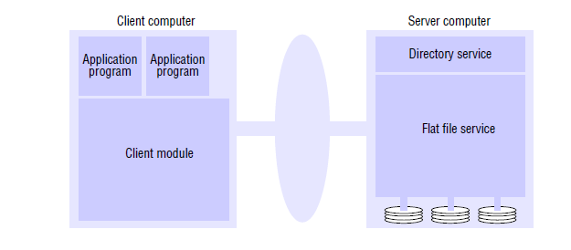
File Service Architecture

Slide 4
Flat File service
The flat file service is concerned with implementing operations on the contents of files.
Unique file identifiers (UFIDs) are used to refer to files in all requests for flat file service operations.
UFIDs are unique long sequences of bits chosen.
When the flat file service receives a request to create a file, it generates a new UFID for it and returns the UFID to the requester.

Slide 5
Directory service
The directory service provides a mapping between text names for files and their UFIDs.
Clients may obtain the UFID of a file by quoting its text name to the directory service.
The directory service provides the functions needed to generate directories, to add new file names to directories and to obtain UFIDs from directories.
It is a client of the flat file service.

Slide 6
Client module
A client module runs in each client computer, integrating and extending the operations of the flat file service and the directory service under a single application programming .
The client module also holds information about the network locations of the flat file server and directory server processes.
Finally, the client module can play an important role in achieving satisfactory performance through the implementation of a cache of recently used file blocks at the client.

Slide 7
Flat File Service Interface
A FileId is invalid if,
the file that it refers to is not present in the server processing the request
its access permissions are inappropriate for the operation requested.
All of the procedures in the interface except Create throw exceptions if the FileId argument contains an invalid UFID or the user doesn’t have sufficient access rights.

Slide 8
File Service Operations
The Read and the Write operation require a parameter i specifying a position in the file.
The Read operation copies the sequence of n data items beginning at item i from the specified file into Data, then returned to the client.
The Write operation copies the sequence of data items from Data into the specified file beginning at item i.
replacing the previous contents of the file at the corresponding position
Extending the file if necessary.

Slide 9
Create creates a new, empty file and returns the UFID that is generated.
Delete removes the specified file.
GetAttributes and SetAttributes enable clients to access the attribute record.
GetAttributes is normally available to any client that is allowed to read the file.
Access to the SetAttributes operation would normally be restricted to the directory service that provides access to the file.
The values of the length and timestamp portions of the attribute record are not affected by SetAttributes; they are maintained separately by the flat file service itself.

Slide 10
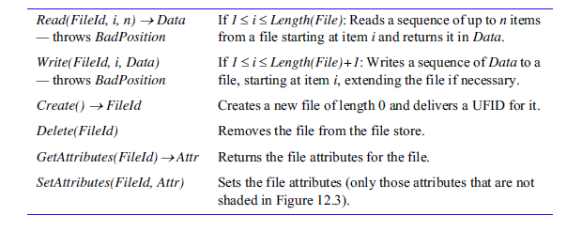

Slide 11
SUN NFS
The NFS server module resides in the kernel on each computer that acts as an NFS server.
Requests referring to files in a remote file system are translated by the client module to NFS protocol operations and then passed to the NFS server module .
The NFS client and server modules communicate using remote procedure calls.
A port mapper service is included to enable clients to bind to services in a given host by name.

Slide 12
The RPC interface to the NFS server is open: any process can send requests to an NFS server; if the requests are valid and they include valid user credentials, they will be acted upon.
The submission of signed user credentials can be required as an optional security feature, as can the encryption of data for privacy and integrity.

Slide 13
Virtual File System
A virtual file system (VFS) module, has been added to the UNIX kernel.
It is used to distinguish between local and remote files.
To translate between the UNIX-independent file identifiers used by NFS and the internal file identifiers normally used in UNIX and other file systems.
It keeps track of the file systems that are currently available both locally and remotely.
It passes each request to the appropriate local system module.

Slide 14
File Handles
The file identifiers used in NFS are called file handles.
A file handle contains whatever information the server needs to distinguish an individual file.
In UNIX implementations of NFS, the file handle is derived from the file’s i-node number by adding two extra fields.

Slide 15
File Handle fields
Filesystem identifier:
a unique number that is allocated to each filesystem when it is created.
i-node number of file:
a number that serves to identify and locate the file within the file system in which the file is stored.
i-node generation number:
i-node numbers are reused after a file is removed.
In the VFS extensions to the UNIX file system, a generation number is stored with each file and is incremented each time the i-node number is reused.

Slide 16
Client Integration
The NFS client module supplying an interface suitable for use by conventional application programs.
It is integrated with the kernel and not supplied as a library for loading into client processes so that:
user programs can access files via UNIX system calls without recompilation or reloading;
a single client module serves all of the user-level processes, with a shared cache of recently used blocks
the encryption key used to authenticate user IDs passed to the server can be retained in the kernel, preventing impersonation by user-level clients.

Slide 17
Access control and authentication
The NFS server is stateless and does not keep files open on behalf of its clients.
The server must check the user’s identity against the file’s access permission attributes on each request.
The Sun RPC protocol requires clients to send user authentication with each request and this is checked against the access permission in the file attributes.

Slide 18
